Slide 2
Digraphs and Relations
Directed graphs
Adjacency
Out-degree and In-degree
Directed Paths and Directed Cycles

Slide 3
What is a digraph?
Short for a “Directed Graph".
A digraph is comprised of vertices and edge (common to all area of graph theory, but edges are directed - often indicated with arrows)
Digraphs are very useful for visualizing relations.
Very useful for a variety of IT applications (e.g. multistate process (behaviour of AI player) and project management).

Slide 4
Blank Page

Slide 5
Blank Page

Slide 6
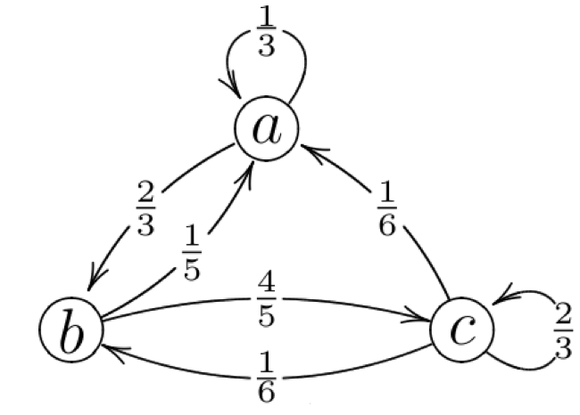
Example of a Digraph

Slide 7
What is a relation?
A "relation" is just a relationship between sets of information.
Useful for mathematically expressing behaviour and interaction of AI players in computer games.

Slide 8
Formal Definition of a Relation
Let S be a set, which includes the elements x and y.
A relation R on S is a rule which compares any two elements of the set S
The relation tells us either that x is related to y or that x is not related to y.
We write xRy to mean “x is related to y under the relation R”.

Slide 9
Relations
A relation R on set S is a rule which compares any two elements (x and y) of S and tell us whether or not x and y are related.
Notation: xRy : x is related to y under relation R

Slide 10
Blank Page

Slide 11
Blank Page

Slide 12
Functions and Relations
The use of the term "relation" is often used to refer to binary relations, where the set of all the starting points is called the domain and the set of the ending points is the range.
An example for such a relation might be a function.

Slide 13
Types of Relations
Relations can be reflexive. One example of a reflexive relation is "is equal to". X "is equal to" X.
Relations can be symmetric. One example of a symmetric relation is again "is equal to". If X "is equal to" Y, then we can say Y "is equal to" X.
Relations can be transitive. One example of a transitive relation is "smaller-than". If X "is smaller than" Y, and Y is "smaller than" Z, then X "is smaller than" Z.

Slide 14
Types of Relations
Let R be a relation defined on a set S.
We say that R is:
reflexive if for all x ∈ S, we have xRx.
symmetric if for all x, y ∈ S such that xRy, we have yRx.
transitive if for all x, y, z ∈ S such that xRy and yRz, we have xRz.

Slide 15
Blank Page

Slide 16
Blank Page

Slide 17
Neighbours
Discuss whether or not the following relations are reflexive, symmetric and transitive.
.... is a next door neighbour of....
.... is a neighbour of....
.... lives on the same street as.....
Name | Address
Ann | No. 1 O’Brien St
Barry | No. 2 O’Brien St
Colm | No. 3 O’Brien St
Deirdre | No. 4 O’Brien St

Slide 18
Relations Example
In a tournament with four players A, B, C, D every player plays
every other player exactly once, although B and D have not
played each other yet. The results are as follows:
A beats B and C
B beats C
D beats A and C.
Draw a digraph to model this information. Explain what the
vertices of the digraph represent and what an arc from one
vertex to another represents.

Slide 19
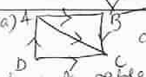
Digraph

Slide 20
Relations Example
R is the relation represented by this digraph.
Determine whether or not R is reﬂexive, symmetric or transitive.

Slide 21
Relations
Vertices represent the players. Edges from one
vertex to another indicate whether or not they
have beaten each other.
Reflexive – No. no player beats themselves
Symmetric – No. Only one player can win a game
Transitive – No. Matches are independent. Also B may still beat D.

Slide 22
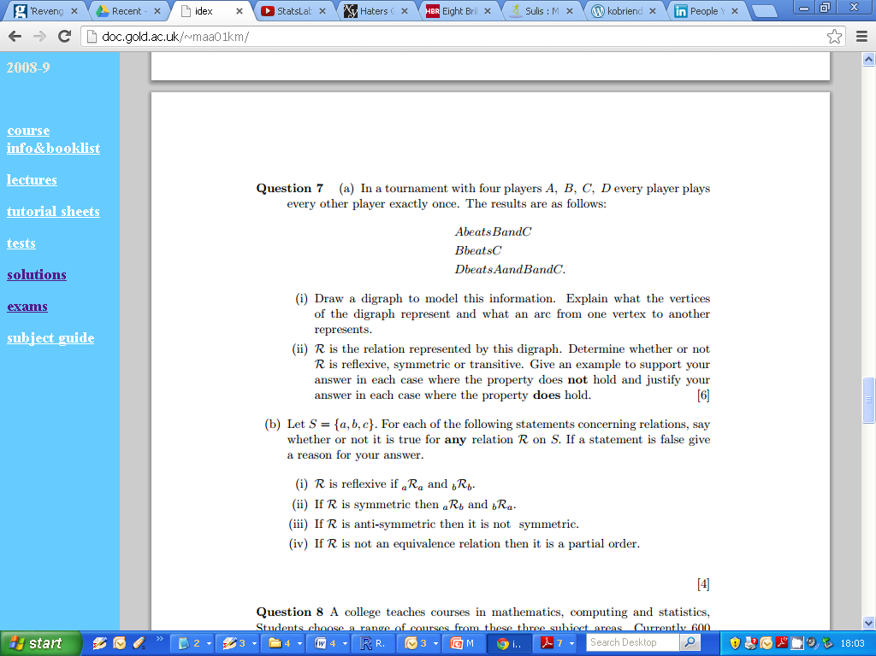
Tournament Example : Digraph

Slide 23
Tournament Example : Digraph

Slide 24
Equivalence Relations
Let R be a relation defined on a set S.
R is reflexive : If for all x ∈ S, we have xRx

Slide 25
Blank Page

Slide 26
Blank Page

Slide 27
Equivalence Relations
Let R be a relation defined on a set S.
R is symmetric : If for all x,y ∈ S, such that if we have xRy, we have yRx.

Slide 28
Equivalence Relations
Let R be a relation defined on a set S.
R is transitive : If for all x,y,z ∈ S, we have xRy and yRz, we have xRz.

Slide 29
Tournament Example

Slide 30
Tournament Example
Reflexive
Symmetric
Transitive

Slide 31
Consider the set A = {1,2,3} and the relation: R = {(1,1), (1,2), (2,1),(2,3)}. We draw the digraph and matrix of the relation.

Slide 32
Blank Page

Slide 33
Blank Page

Slide 34
Relations
Consider the set A = {1,2,3} and the relation: R = {(1,1), (1,2), (2,1),(2,3)}. We draw the digraph and matrix of the relation.
R is not reflexive since 2 is not related to 2. We can interpret the digraph by seeing that there is no arc of length 1 from 2 to 2. Similarly, the 2-2 entry in the matrix is 0.

Slide 35
Relations
Consider the set A = {1,2,3} and the relation: R = {(1,1), (1,2), (2,1),(2,3)}. We draw the digraph and matrix of the relation.
R is not reflexive since 2 is not related to 2. We can interpret the digraph by seeing that there is no arc of length 1 from 2 to 2. Similarly, the 2-2 entry in the matrix is 0.
R is not symmetric since 2 is related to 3, but 3 is not related to 2. Relate this to digraph and symmetric matrix.

Slide 36
Relations
Consider the set A = {1,2,3} and the relation: R = {(1,1), (1,2), (2,1),(2,3)}. We draw the digraph and matrix of the relation.
R is not reflexive since 2 is not related to 2. We can interpret the digraph by seeing that there is no arc of length 1 from 2 to 2. Similarly, the 2-2 entry in the matrix is 0.
R is not symmetric since 2 is related to 3, but 3 is not related to 2. Relate this to digraph and symmetric matrix.
R is not transitive since 1 R 2 and 2 R 3, but 1 is not related to 3. We must check each pair of points. The matrix way is not discussed here.
R is not antisymmetric since 1 R 2 and 2 R 1, but 1 is not equal to 2. Thus there should be no double arcs in the digraph of an antisymmetric relation.

Slide 37
Relations
Consider the set A = {1,2,3} and the relation: R = {(1,1), (1,2), (2,1),(2,3)}. We draw the digraph and matrix of the relation.
R is not reflexive since 2 is not related to 2. We can interpret the digraph by seeing that there is no arc of length 1 from 2 to 2. Similarly, the 2-2 entry in the matrix is 0.
R is not symmetric since 2 is related to 3, but 3 is not related to 2. Relate this to digraph and symmetric matrix.
R is not transitive since 1 R 2 and 2 R 3, but 1 is not related to 3. We must check each pair of points. The matrix way is not discussed here.

Slide 38
Relations
Consider the set A = {1,2,3} and the relation: R = {(1,1), (1,2), (2,1),(2,3)}. We draw the digraph and matrix of the relation.
R is not reflexive since 2 is not related to 2. We can interpret the digraph by seeing that there is no arc of length 1 from 2 to 2. Similarly, the 2-2 entry in the matrix is 0.
R is not symmetric since 2 is related to 3, but 3 is not related to 2. Relate this to digraph and symmetric matrix.
R is not transitive since 1 R 2 and 2 R 3, but 1 is not related to 3. We must check each pair of points. The matrix way is not discussed here.
R is not antisymmetric since 1 R 2 and 2 R 1, but 1 is not equal to 2. Thus there should be no double arcs in the digraph of an antisymmetric relation.

Slide 39
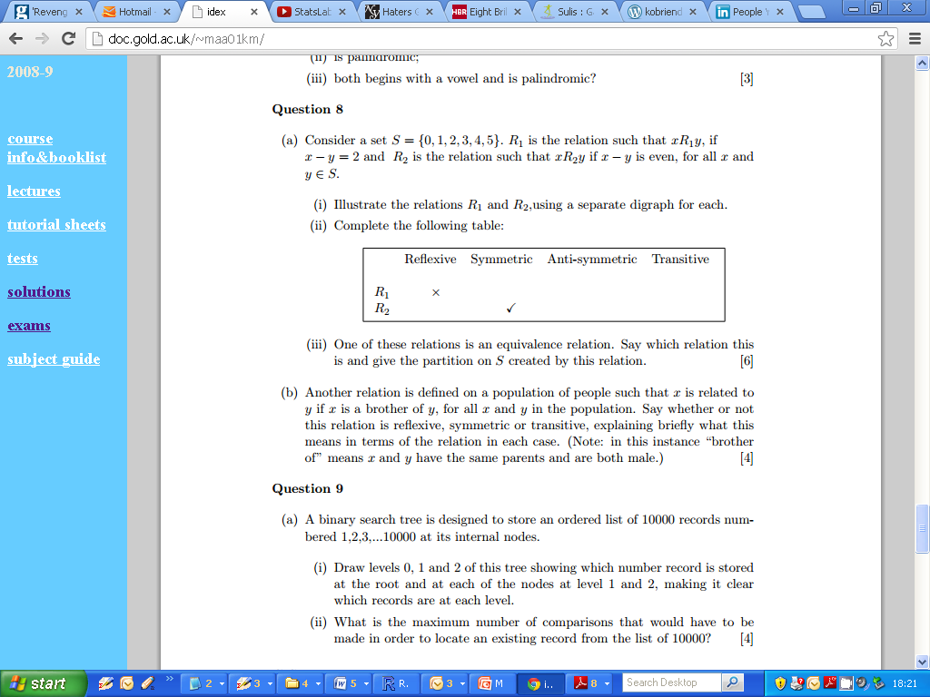
Second Example

Slide 40
Second Example

Slide 41
Second Example

Slide 42

Second Example

Slide 43
Blank Page

Slide 44
Blank Page

Slide 45
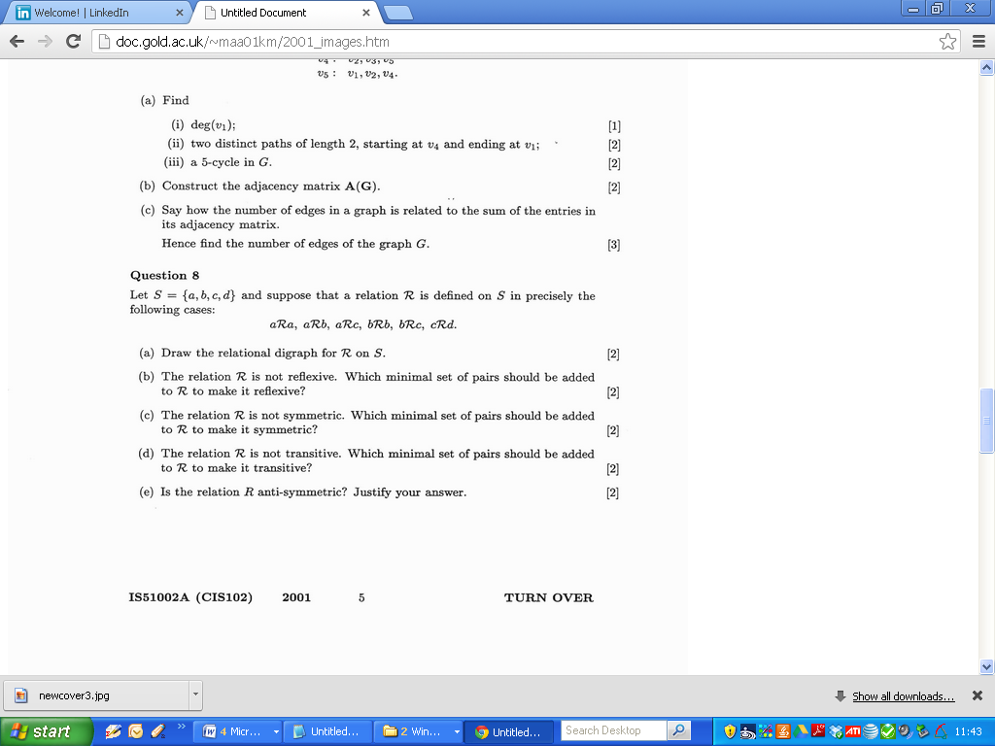
2001

Slide 46
2001

Slide 47
2001

Slide 48
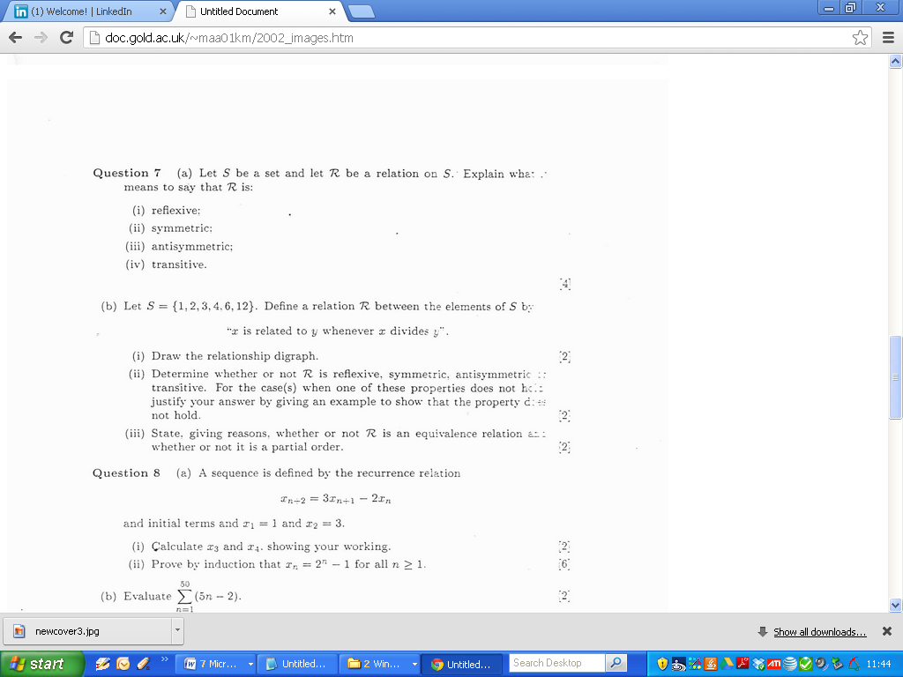
2002

Slide 49
Blank Page

Slide 50
Blank Page

Slide 51
2002

Slide 52
2002

Slide 53
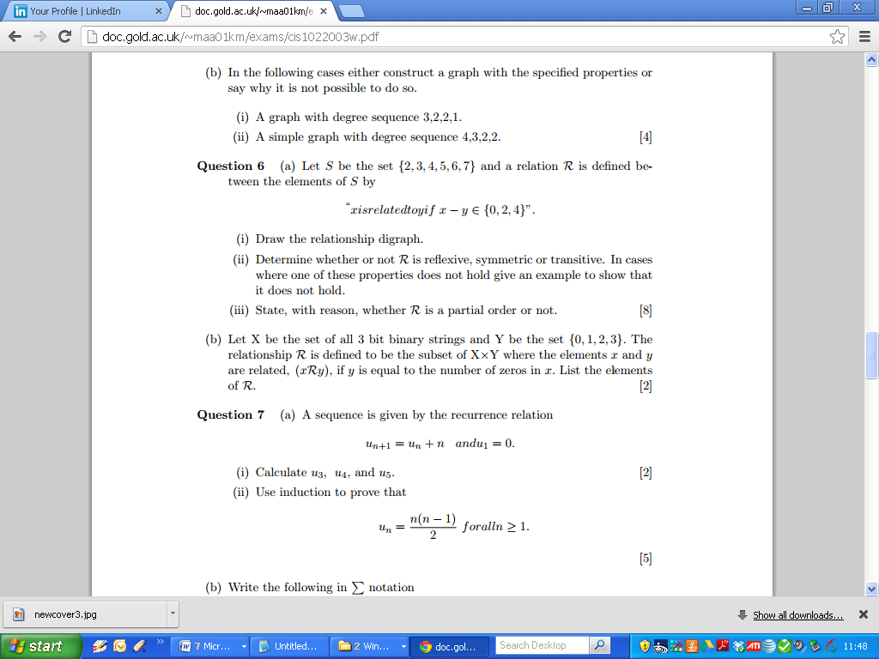
2003

Slide 54
2003

Slide 55
2003

Slide 56
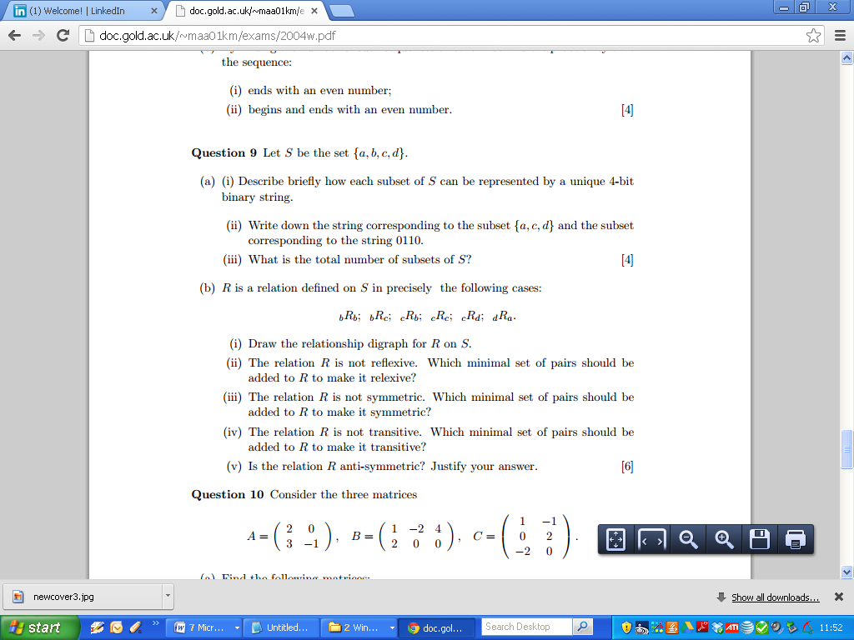
2004

Slide 57
2004

Slide 58
2004

Slide 59
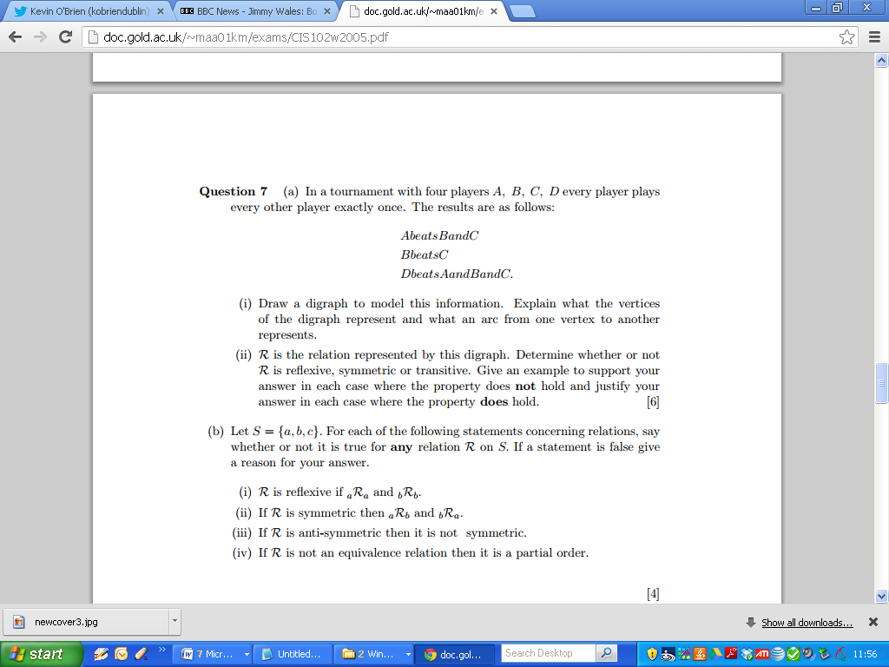
2005

Slide 60
2005

Slide 61
2005

Slide 62
2005

Slide 63
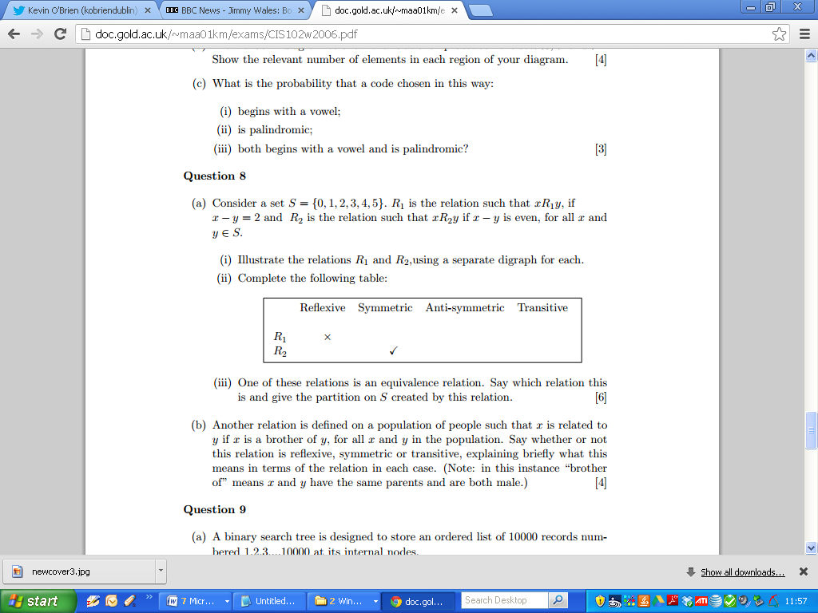
2006

Slide 64
Blank Page

Slide 65
Blank Page

Slide 66
2006

Slide 67
2006

Slide 68
Blank Page

Slide 69
Blank Page

Slide 70
2006

Slide 71
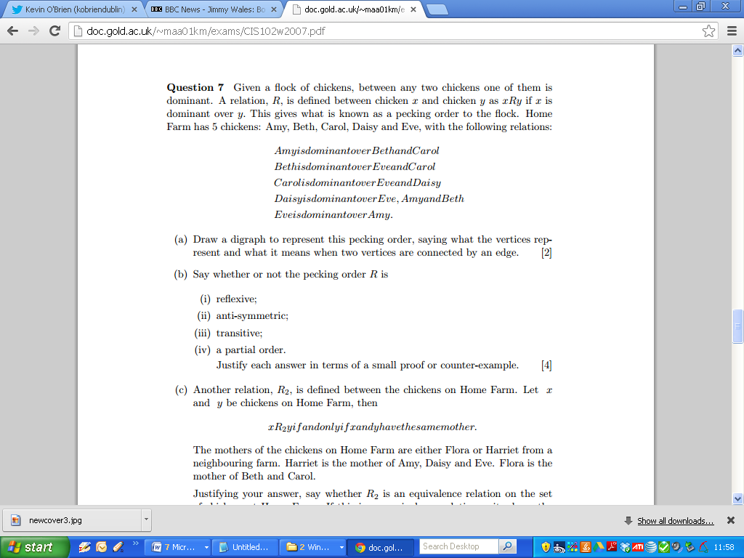
2007

Slide 72
2007

Slide 73
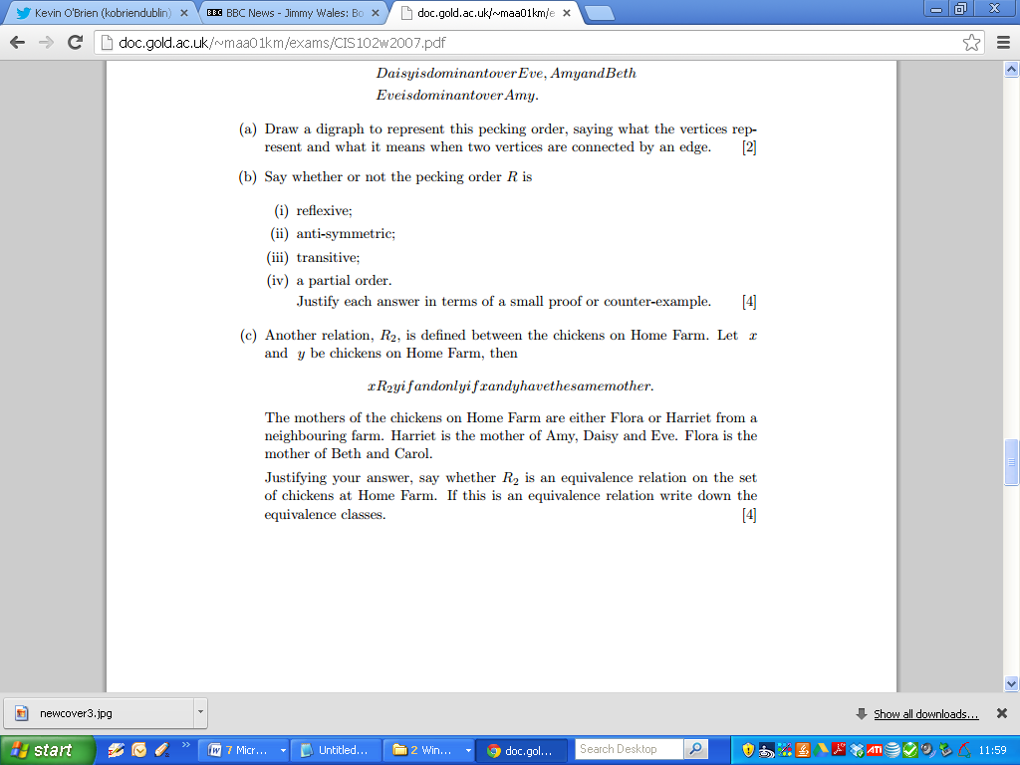
2007

Slide 74
2007

Slide 75
2007

Slide 76
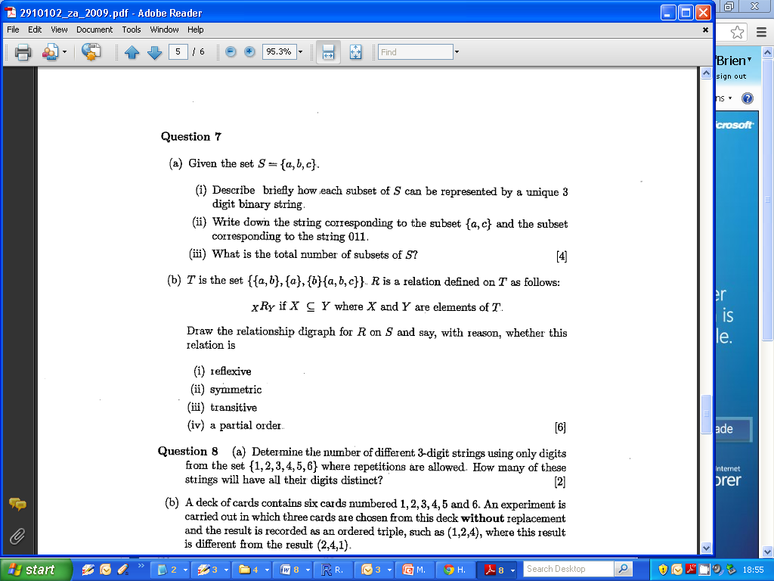
2009 Zone A Q7b

Slide 77
2009 Zone A Q7b
(Digraphs)

Slide 78
2009 Q7
The vertices of the digraph represented sets: {a}, {b}, {a, b} and {a, b, d} and there were directed arcs between vertices when one set was a subset of the other.
Thus there was an arc from {a} to {a, b} and {a, b, d} but not from {a} to {b}.
This relation is reflexive, not symmetric and transitive.
As it is also anti-symmetric it is a partial order.

Slide 79
2009 Zone A Q7b
Anti-Symmetric and Partial Orders
Anti-symmetric: xRy and yRx implies that x=y
Partial Order : Relation is reflexive, anti-symmetric and transitive.

Slide 80
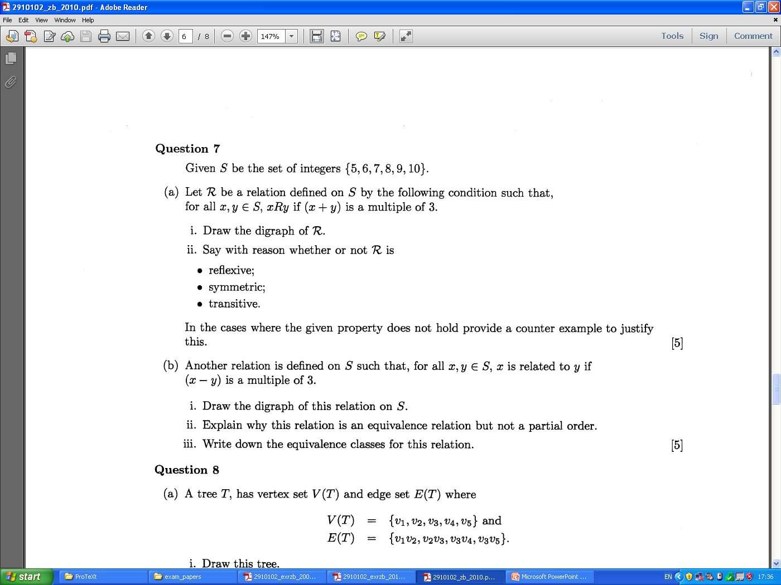
2010

Slide 81
2010

Slide 82
Cartesian Products
Let X and Y be sets. Then the Cartesian product XxY is the set whose elements are all ordered paired of elements (x,y) where x ∈ X and y ∈ Y.
Suppose X = {p,q,r} and Y={a,b,c}
XxY = { (p,a),(p,b),(p,c), YxX
(q,a), (q,b),(q,c),
(r,a),(r,b),(r,c) }

Slide 83
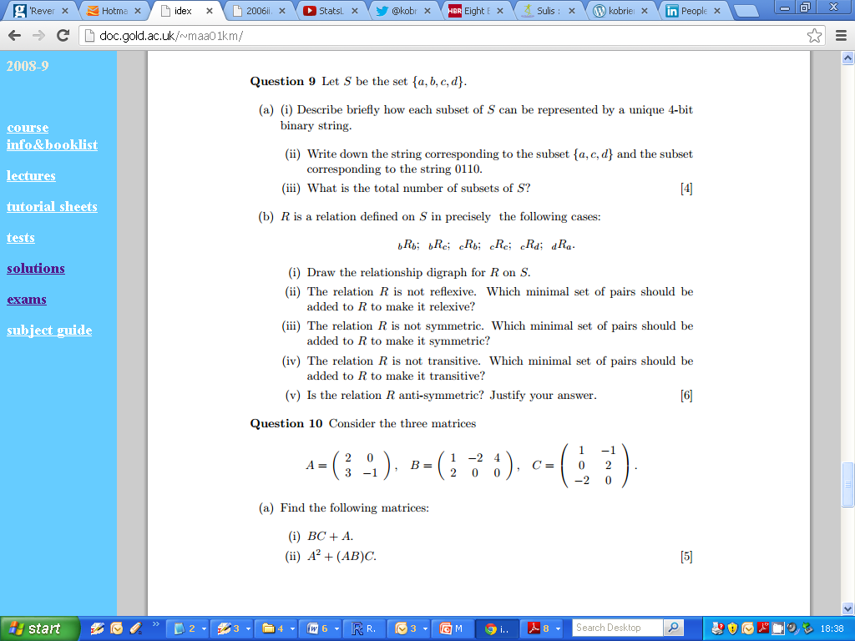
n-bit Binary Strings

